Slide 1
Fundamental Network Programming
Hanle multiple socket connection in C#
Lecturer: MSc. Dang Le Bao Chuong
Spring 2022

Slide 2
Agenda
Socket in C# (cont.)
Handle multiple connections using multi-threading
TcpListener & TcpClient class

Slide 3
Simple client/server socket interaction
server (running on hostid)
client
create socket,
port=x, for incoming request:
serverSocket = socket()
wait for incoming
connection request
TCP
connection setup
create socket,
connect to hostid, port=x
connectionSocket =
serverSocket.accept()
clientSocket = socket()
send request using
clientSocket
read request from
connectionSocket
write reply to
connectionSocket
- Client connection isn’t persisted for later usage
read reply from
clientSocket
close
connectionSocket
close
clientSocket

Slide 4
Dedicated listening thread
private void listen()
{
listener.Bind(new IPEndPoint(IPAddress.Parse(textBox1.Text), _port));
listener.Listen(10);
started = true;
UpdateChatHistoryThreadSafe("Start listening");
while (started)
{
Socket client = listener.Accept();
UpdateChatHistoryThreadSafe("Accept connection from " + client.RemoteEndPoint.ToString());
int readbytes = client.Receive(_buffer);
string s = Encoding.UTF8.GetString(_buffer);
UpdateChatHistoryThreadSafe(s + "\n");
}
}
serverThread = new Thread(this.listen);
serverThread.Start();
What about this Socket ? What if we want to re-use it for later communication with client

Slide 5
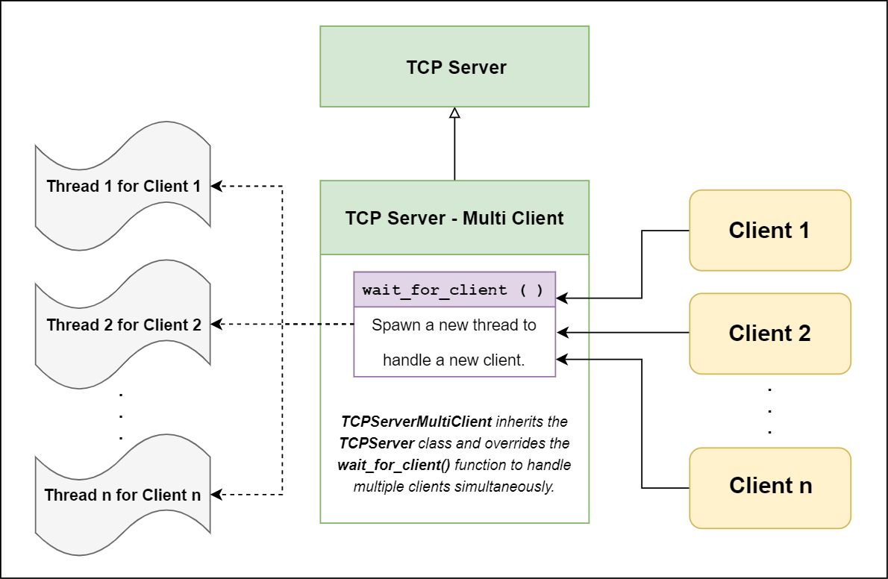
Handle multiple connections

Slide 6
Dedicated thread for reading socket receiving bytes
private void readingClientSocket(Socket client)
{
byte[] buffer = new byte[_buff_size];
while (client.Connected)
{
if (client.Available > 0)
{
StringBuilder sb = new StringBuilder();
while (client.Available > 0)
{
int bRead = client.Receive(buffer, _buff_size, SocketFlags.None);
sb.Append(Encoding.UTF8.GetString(buffer));
}
string receivedStr = client.RemoteEndPoint + ": " + sb.ToString();
UpdateTextThreadSafe(receivedStr, richTextBox1);
foreach (Socket s in clientSockets)
{
s.Send(Encoding.UTF8.GetBytes(receivedStr));
}
}
}
}
Thread clientThread = new Thread(() => this.readingClientSocket(client));
clientThread.Start();

Slide 7
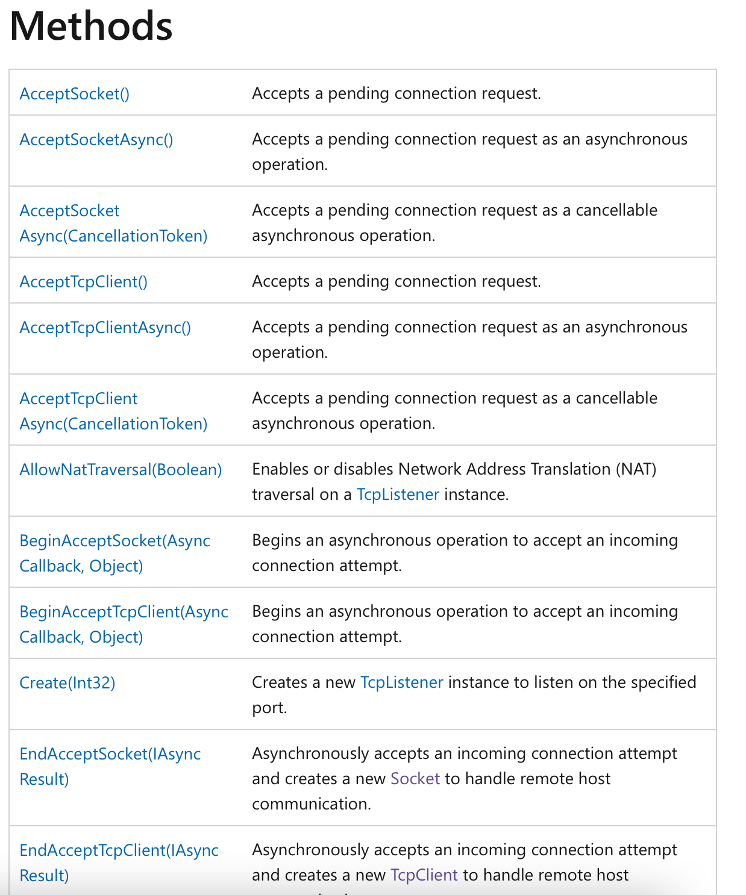
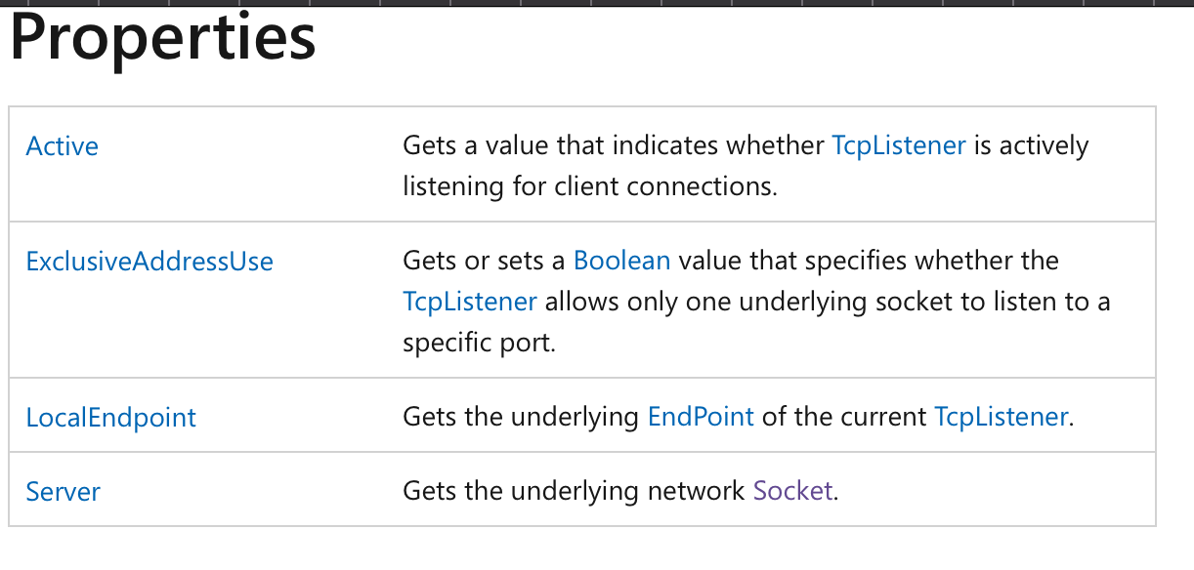
TcpListener

Slide 8
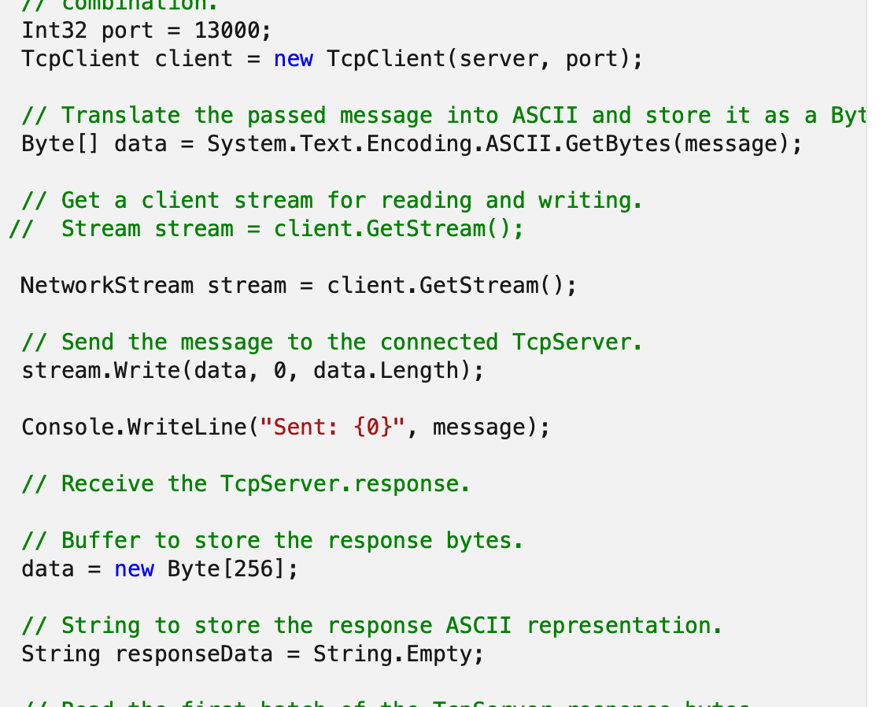
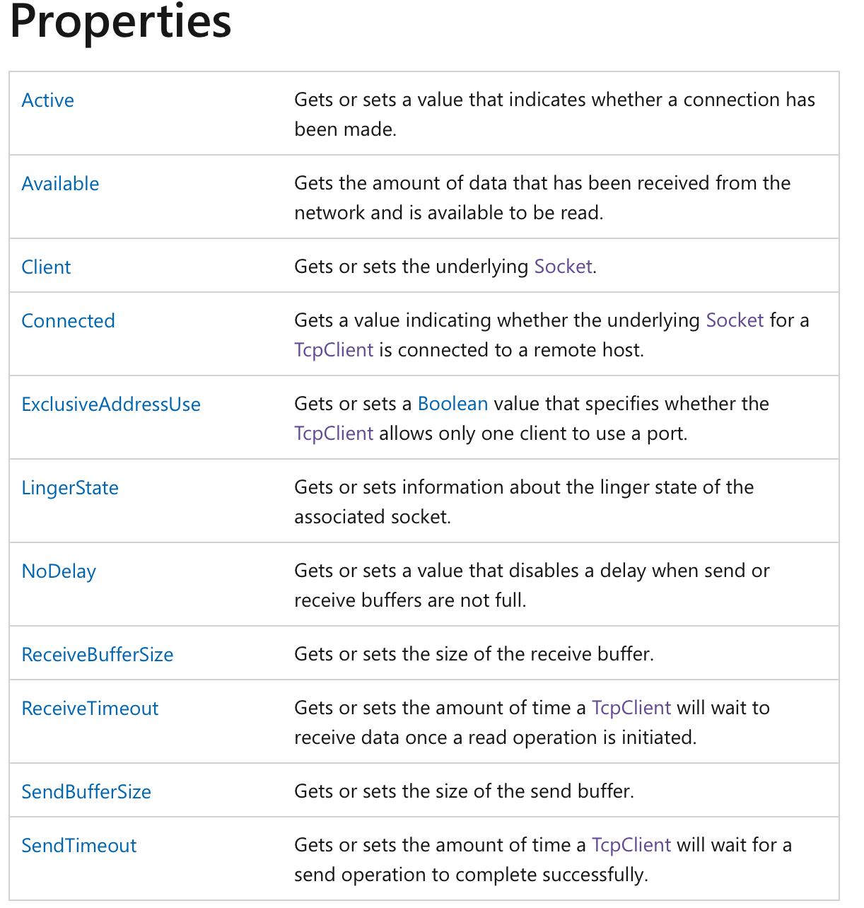
TcpClient

Slide 9
References
Socket: https://docs.microsoft.com/vi-vn/dotnet/framework/network-programming/synchronous-client-socket-example
https://docs.microsoft.com/en-us/dotnet/api/system.net.sockets.tcplistener?view=net-6.0
https://docs.microsoft.com/en-us/dotnet/api/system.net.sockets.tcpclient?view=net-6.0

Slide 10
Assignment week #5
Tcp Chat Server support multiple clients

